Slide 1
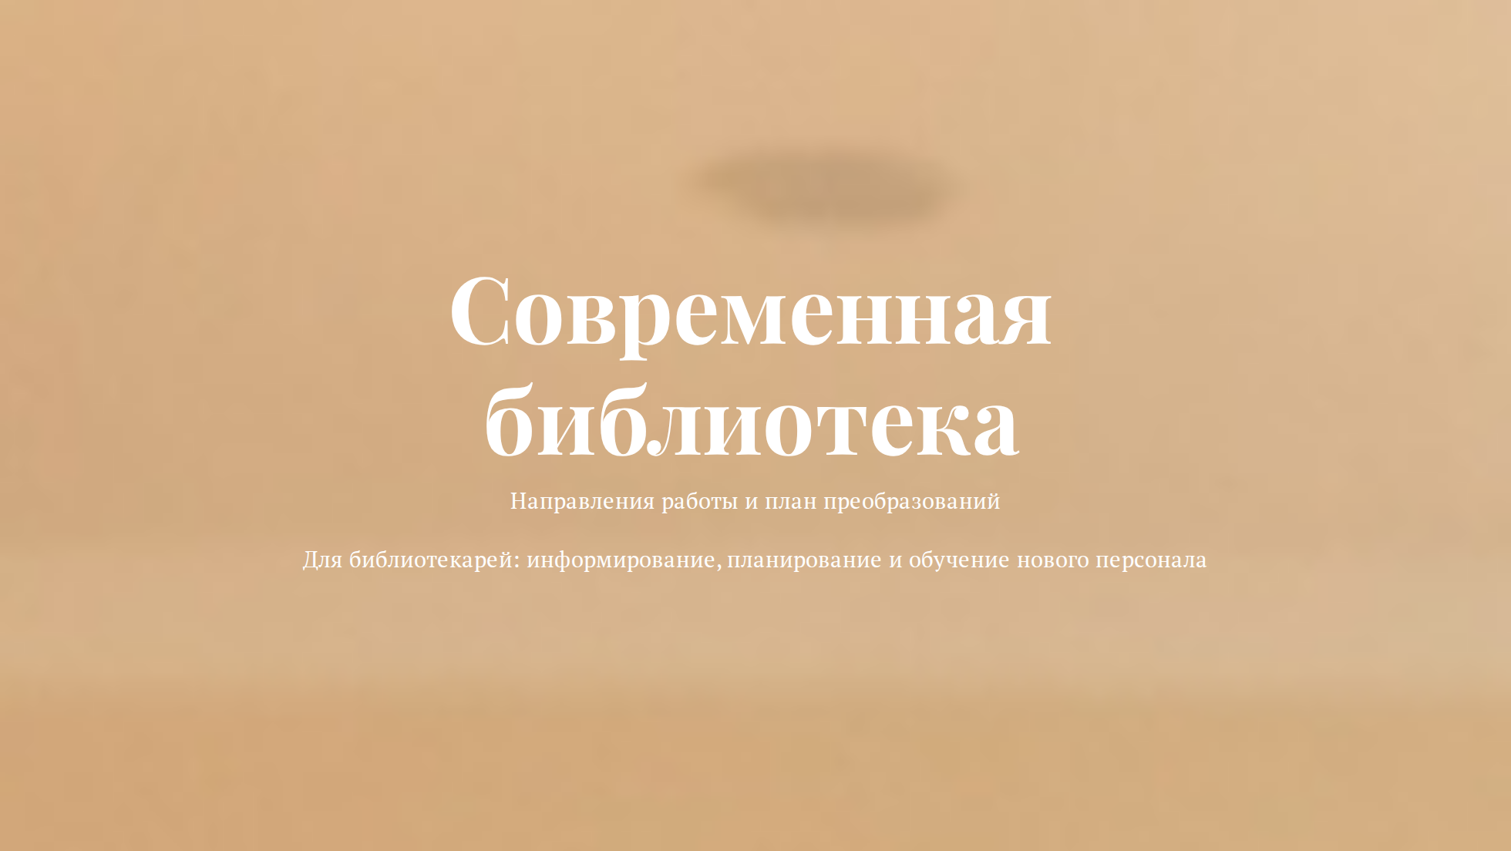

Slide 2
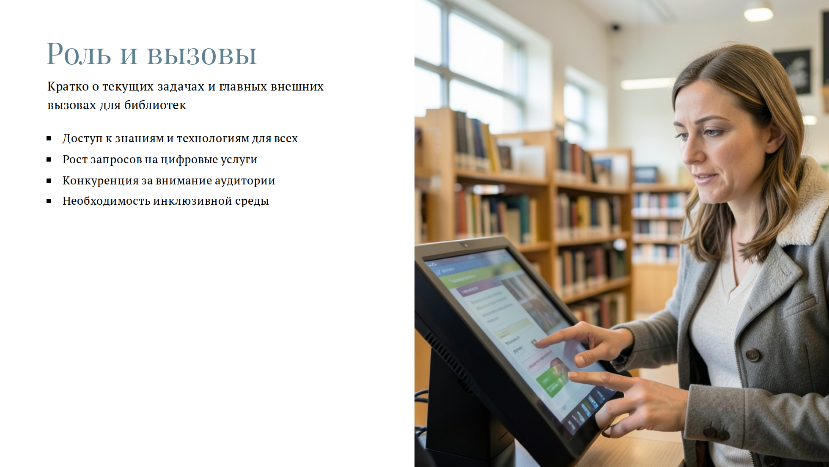

Slide 3
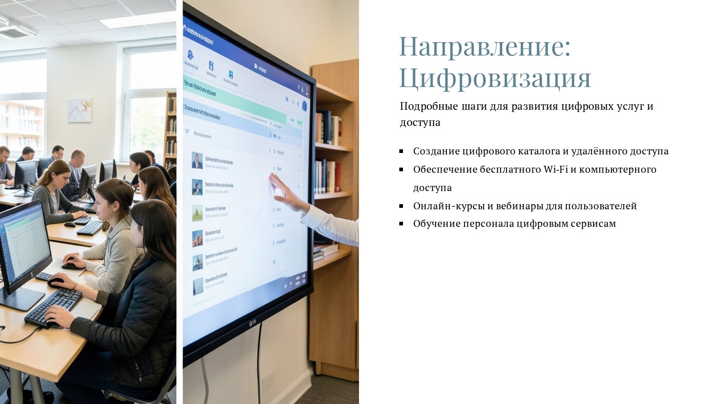

Slide 4


Slide 5


Slide 6
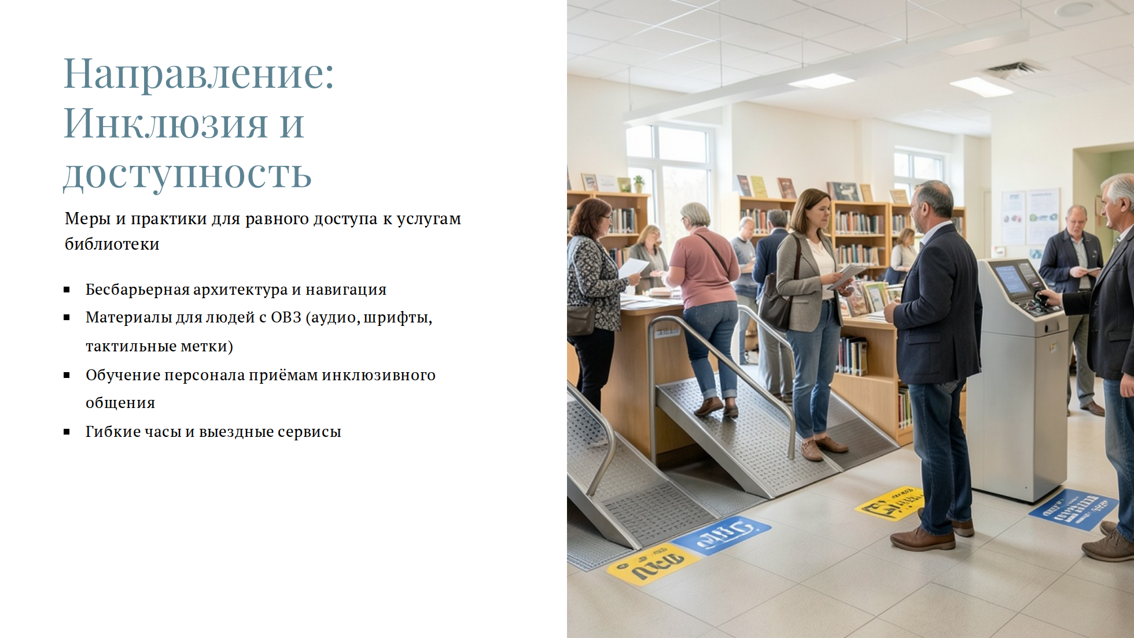

Slide 7


Slide 8


Slide 9

Notes:
frame-accent: #6EE7B7

